Slide 1
Stop the Thumb Scroll: Creating Inclusive and Accessible Social Media Content
IDEAL ’19
August 7, 2019

Slide 2
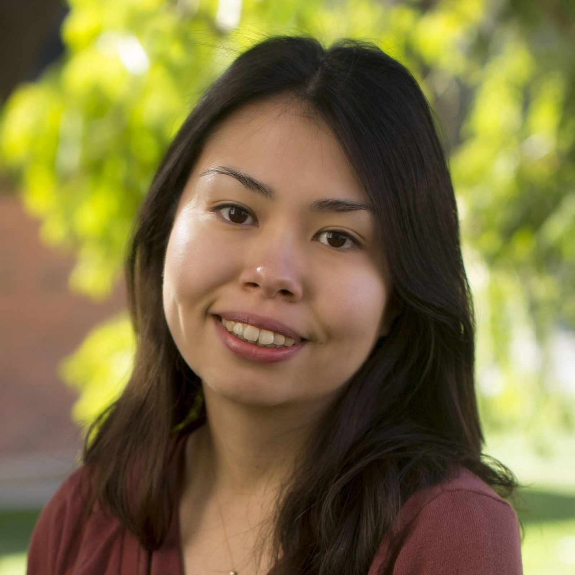

Shelly Black
Marketing Specialist, Associate
University of Arizona Libraries
SFLORES@EMAIL.ARIZONA.EDU

Slide 3
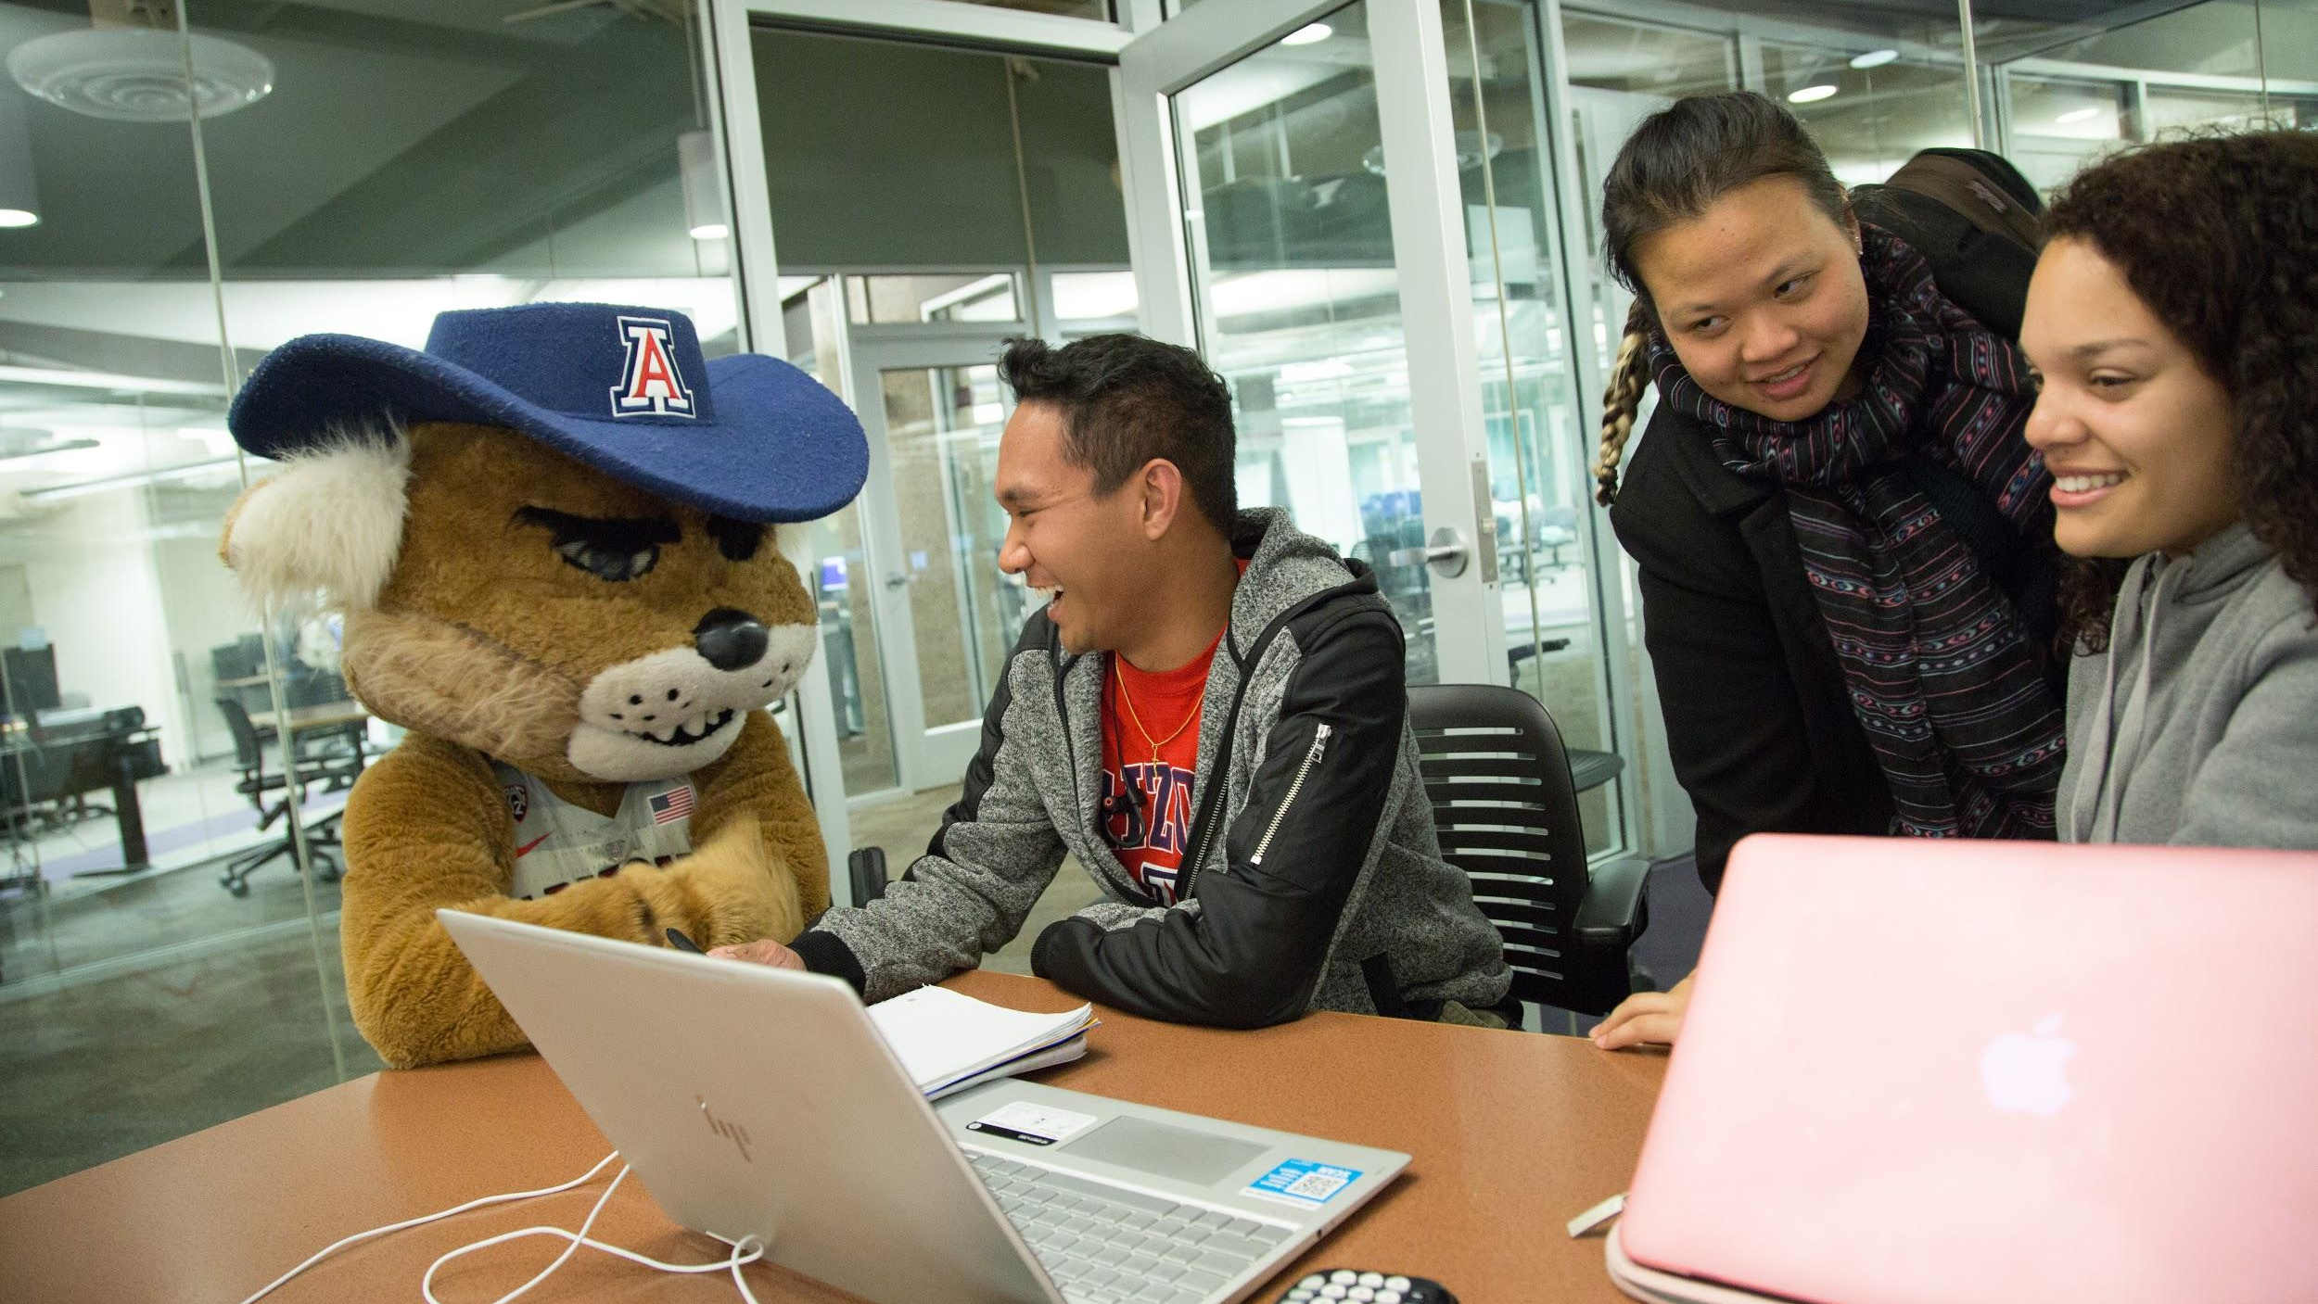
What is inclusive & accessible content?

Slide 4

Photos

Slide 5
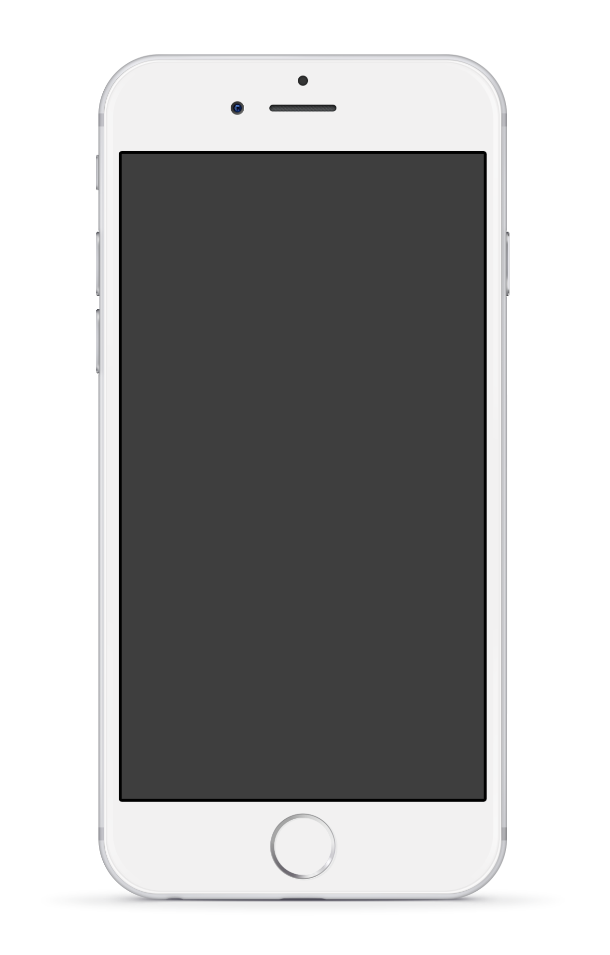
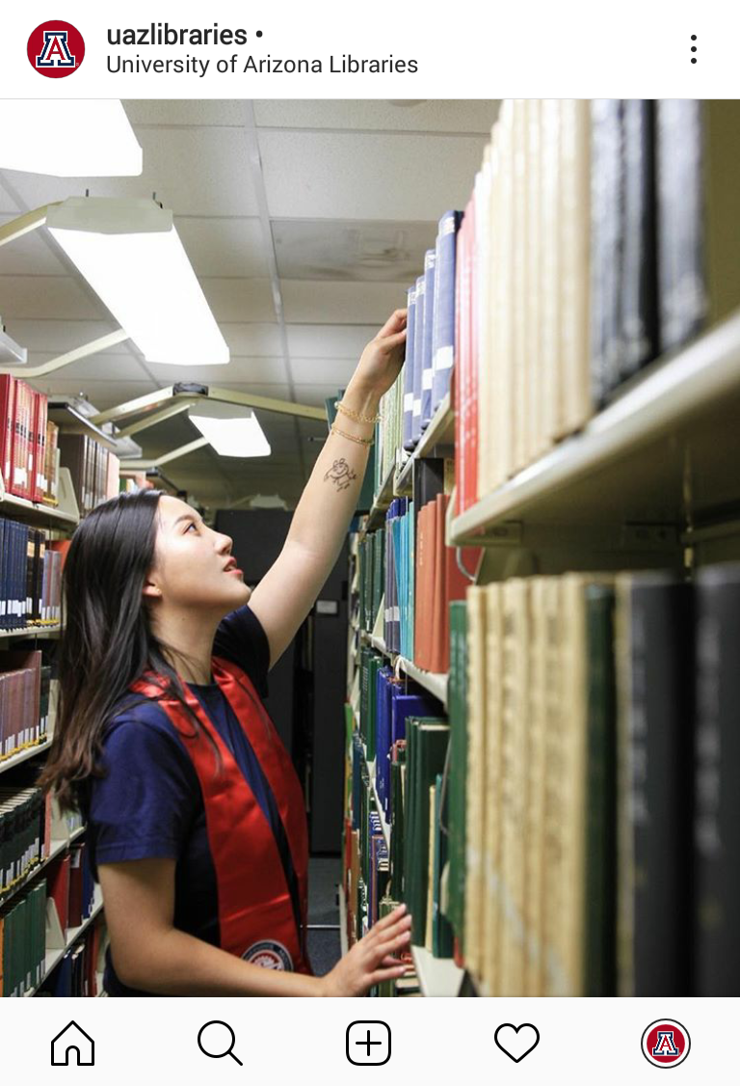
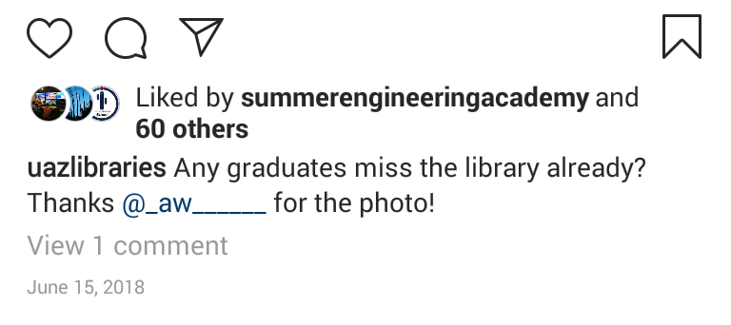
Representation
Diversify the people in your photos, but avoid tokenism
Use stock photos when needed
Share user-generated content

Slide 6
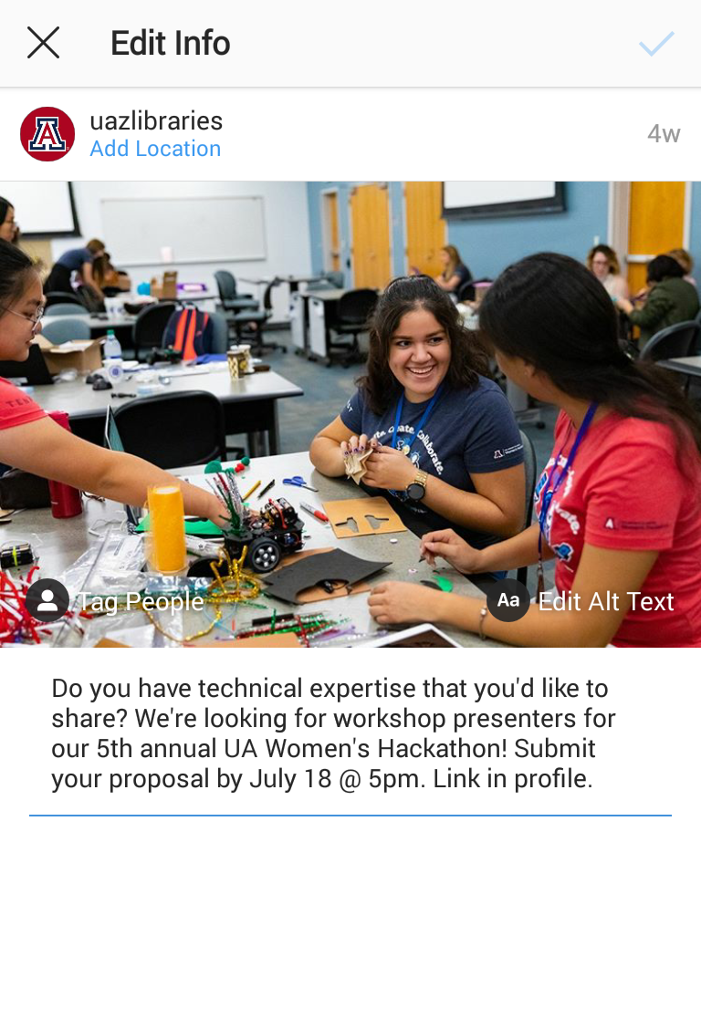
Alt Text
Accessible to people with visual impairments using assistive tech, e.g. screen readers
Now available on Facebook, Twitter, and Instagram

Slide 7

Videos

Slide 8

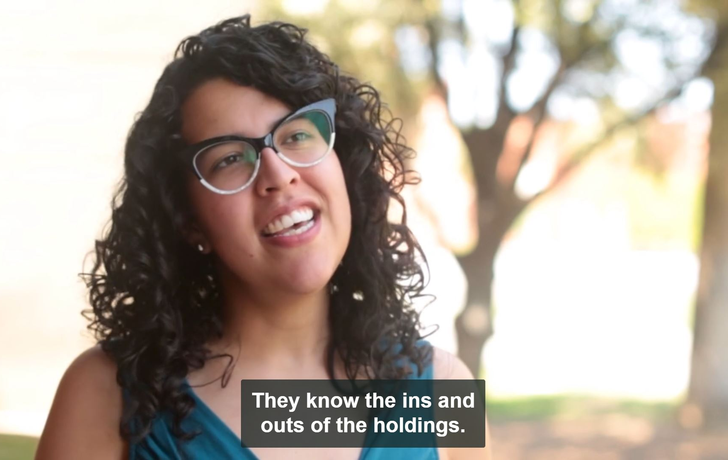
Captions/Transcripts
Essential for people who are deaf or hard of hearing
Required to be compliant with Americans with Disabilities Act

Slide 9
Language

Slide 10

Inclusive Writing
Use gender-neutral pronouns, e.g. “they/them/theirs”
Use people-first language, e.g. “people who are visually impaired” instead of “the blind”
Use plain language by avoiding verbose sentences, jargon, & idioms

Slide 11

Graphic Design

Slide 12

Accessibility
Design for color blindness
Use a hierarchy of text & images
Choose a legible font & make your text readable

Slide 13
RESOURCES
GRAPHIC DESIGN & PHOTOS
AccessAbility: A Practical Handbook on Accessible Graphic Design https://www.rgd.ca/database/files/library/RGD_AccessAbility_Handbook.pdf A handbook of principles for print, web, and environmental design from the Association of Registered Graphic Designers of Ontario, with support from the Government of Ontario.
Coblis — Color Blindness Simulator
https://www.color-blindness.com/coblis-color-blindness-simulator/
Color Contrast Checker
https://webaim.org/resources/contrastchecker/
Disability Inclusive Stock Images http://www.pushlivingphotos.com/ Photos start from $35. Sales support photographer royalties and real models with disabilities.
The Gender Spectrum Collection: Stock Photos Beyond the Binary https://broadlygenderphotos.vice.com/ Images of trans and non-binary models available under the Creative Commons Attribution -NonCommercial-NoDerivatives license.
The Jopwell Collection https://jopwellcollection.jopwell.com/thejopwellcollection/ More than 100 free stock photos featuring Black, Latinx, and Native American students and professionals at work, available under a Creative Commons Attribution license.

Slide 14
RESOURCES (cont.)
Nappy https://www.nappy.co/ Photos of people of color available under the Creative Commons Zero license.
WOCinTech Chat https://www.flickr.com/photos/wocintechchat/ Stock photos of women of color in tech, licensed under a Creative Commons Attribution license.
WRITING
Conscious Style Guide https://consciousstyleguide.com/ The latest news, opinions, and guides on inclusive, respectful, and empowering language.
Guidelines: How to Write and Report About People with Disabilities (8th ed.) http://rtcil.org/products/media/guidelines “First published in 1984, the Guidelines brochure has become a classic on person-first language.”
Radical Copyeditor https://radicalcopyeditor.com/ Alex Kapitan’s writing advice on how to be sensitive and anti-oppressive with regards to race, class, sexuality, gender, ability, age, body size, religion, nationality, and more.
CREDITS: Presentation template by Slidesmash. User-Generated Content slide photo by Instagram user _aw______. Inclusive Writing slide photo by The Gender Spectrum Collection. All other photos by University of Arizona Libraries.

Slide 15

Thank you!
SFLORES@EMAIL.ARIZONA.EDU

